Slide 1


The Journey of Advancing Mathematical Reasoning
Zihao Zhou
UoL & XJTLU
zihao.zhou@liverpool.ac.uk
https://zhouzihao501.github.io

Slide 2

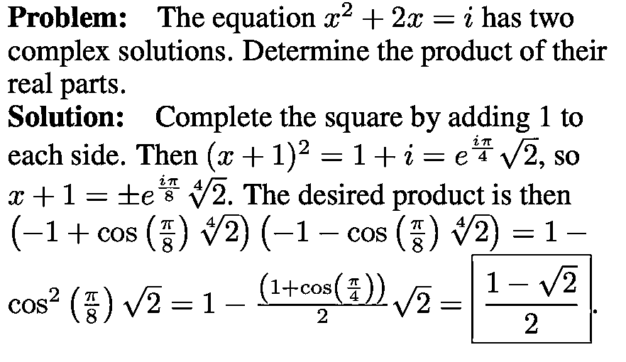

Reasoning…
Math Problem Answer
Notes:
· My task is solving MWP
· Given an MWP, the model should…

Slide 3
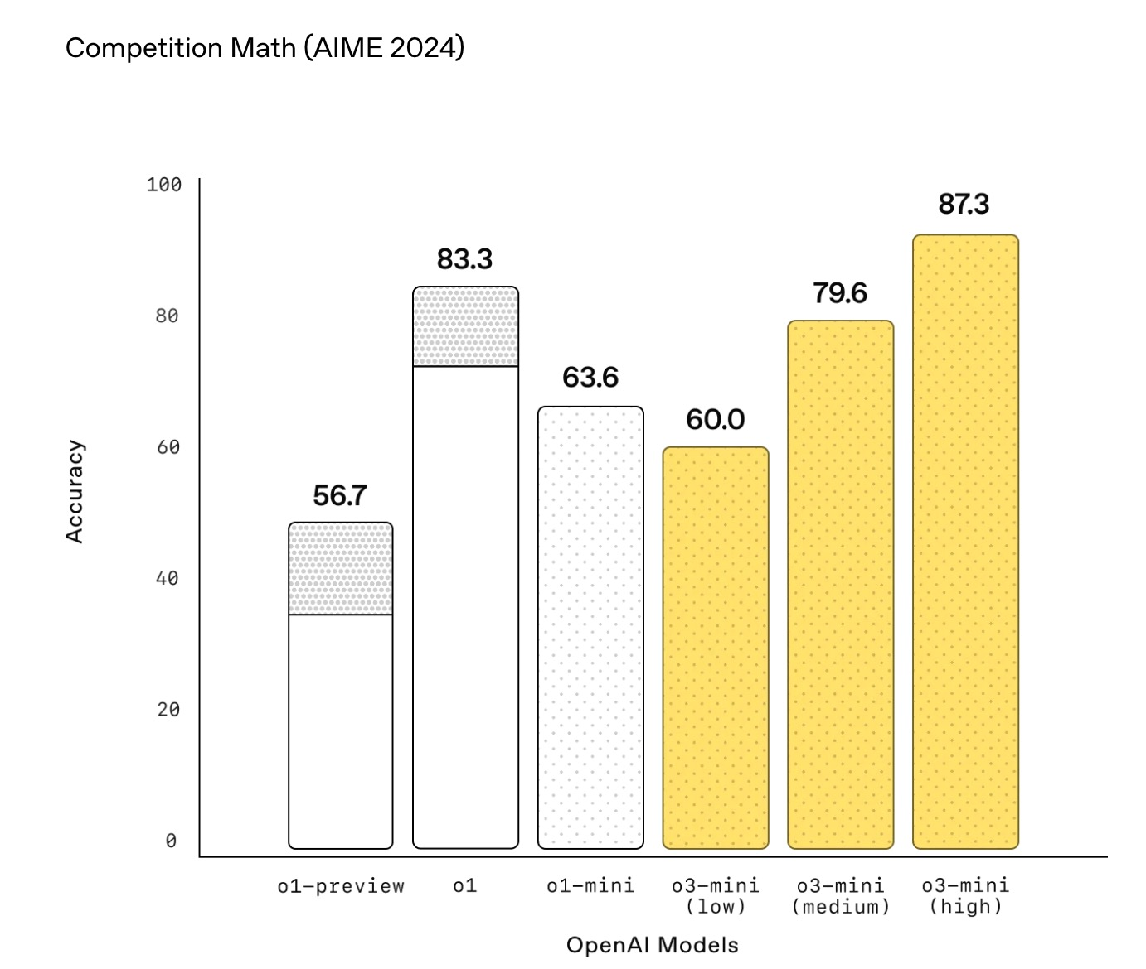
Why we work on mathematical reasoning?
🤔
Testbed:
It stands as a crucial testbed for LLMs “intelligence”.
Notes:
· Why we work on
· stands as…: so many company

Slide 4
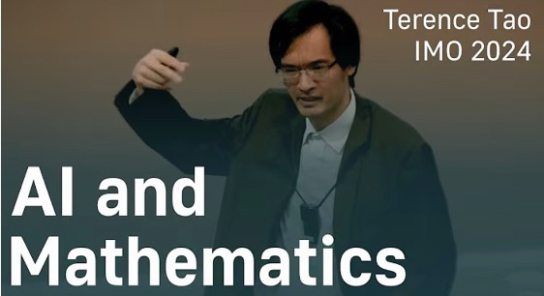
Why we work on mathematical reasoning?
🤔
Testbed:
It stands as a crucial testbed for LLMs “intelligence”.
Application:
It is applied in various real-world domains, such as education and AI for math science.
Notes:
· application: use math reasoner to help this area

Slide 5
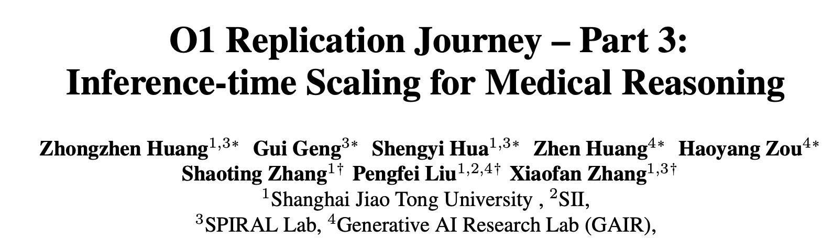
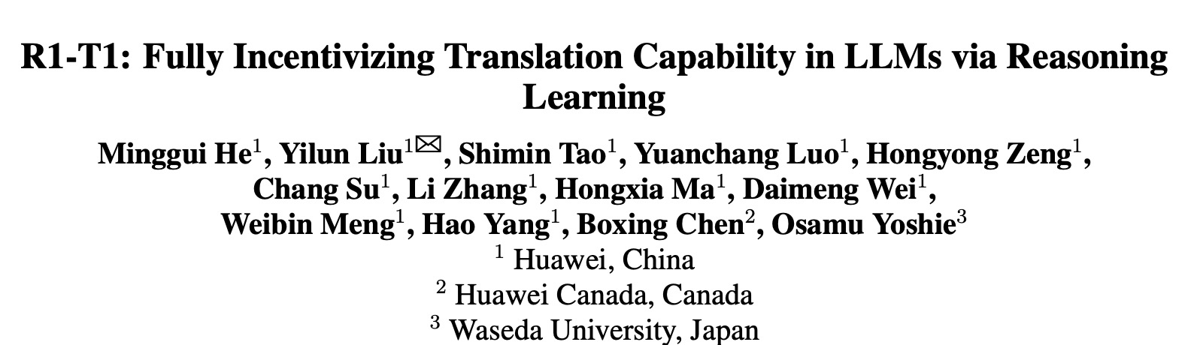
Why we work on mathematical reasoning?
🤔
Testbed:
It stands as a crucial testbed for LLMs “intelligence”.
Application:
It is applied in various real-world domains, such as education and AI for math science.
Transferability: These techniques can transfer well to other fields.
Notes:
Trans: when we work on math, these techniques and idea can…
· So our goal is…,and the tech or model can help in this three aspects.

Slide 6
Talk Overview
· Part 1: Boosting Mathematical Reasoning with Synthetic Data
· Part 2: Evaluating Mathematical Reasoning of Large Language Models
· Part 3: Advancing Math Reasoning with Environment Learning

Slide 7
Talk Overview
· Part 1: Boosting Mathematical Reasoning with Synthetic Data
· Part 2: Evaluating Mathematical Reasoning of Large Language Models
· Part 3: Advancing Math Reasoning with Environment Learning

Slide 8
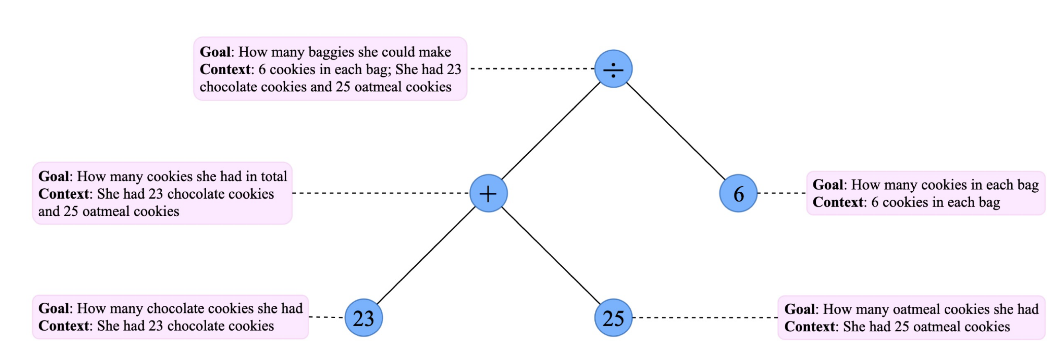
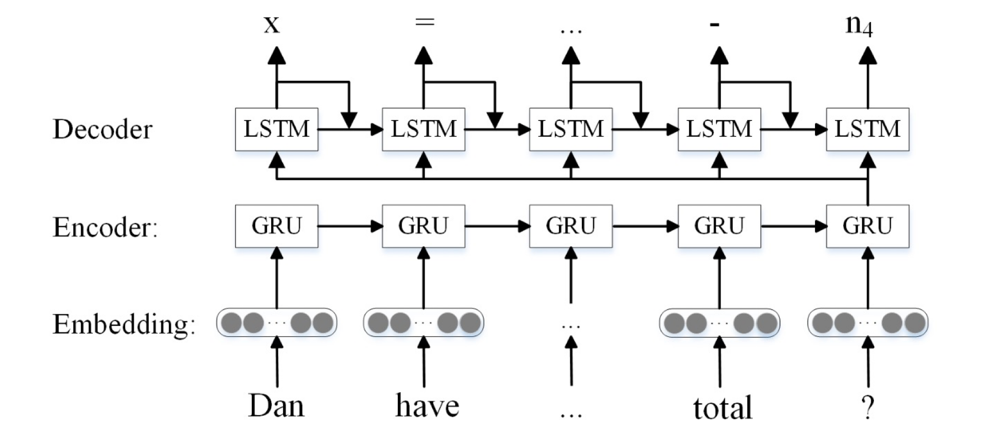
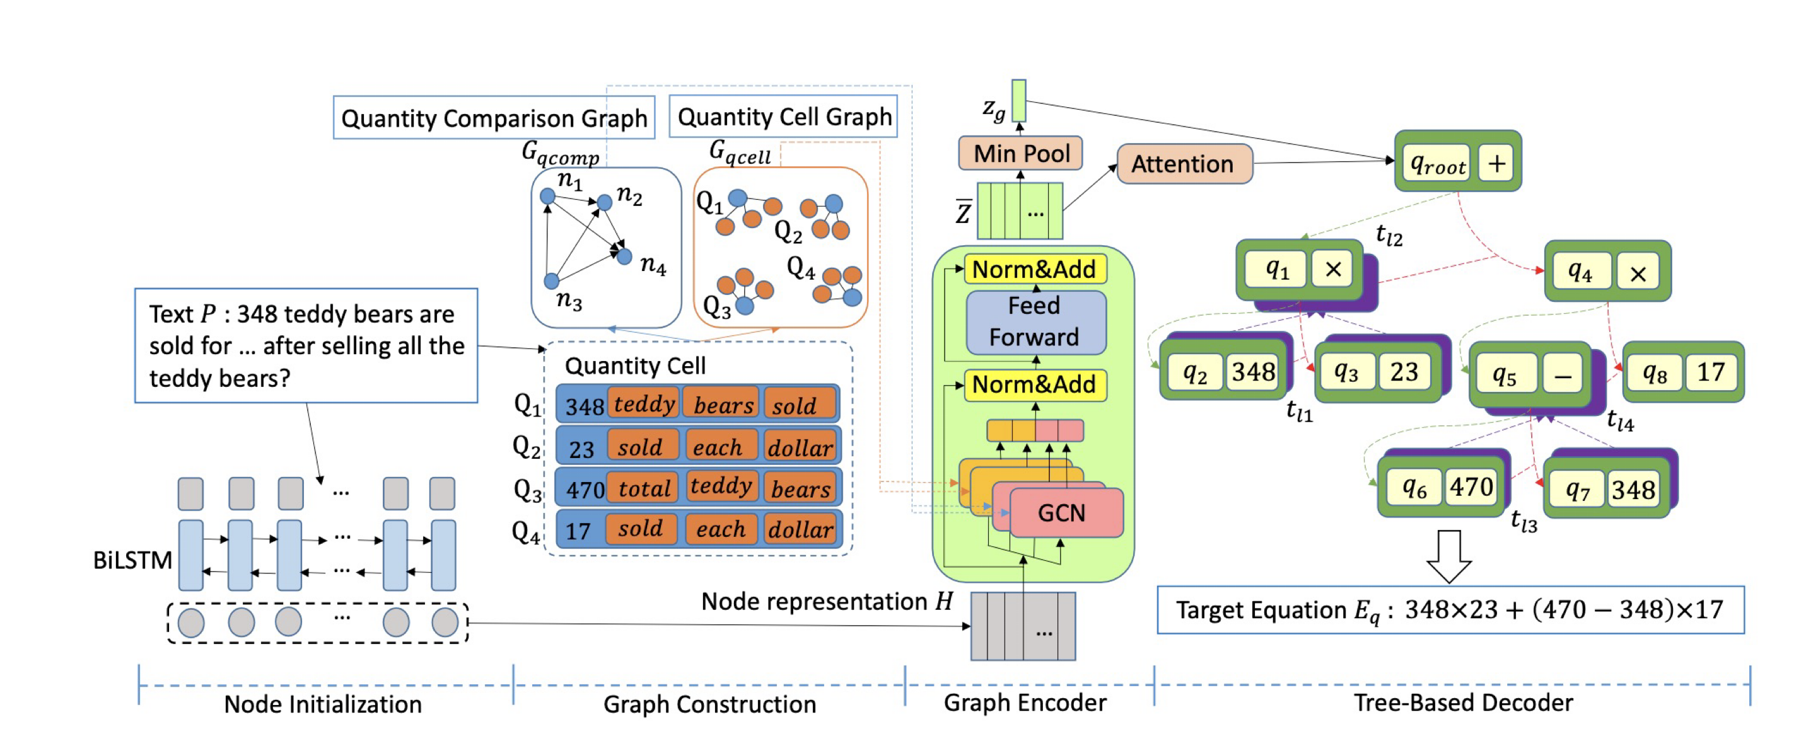
Traditional Math Solver
Seq2Tree
Problem: Dan have 2 pens, Jessica have 4 pens. How many pens do they have in total ?
Equation: 4+2
Seq2Seq
Graph2Tree

Slide 9
· The high-quality math reasoning is scarce and is the key for reasoning task.
· Math reasoning problem data is hard to annotate by humans.
Notes:
The data challenge is:

Slide 10
· The high-quality math reasoning is scarce and is the key for reasoning task.
· Math reasoning problem data is hard to annotate by humans.
Synthetic Data
Notes:
The data challenge is:

Slide 11
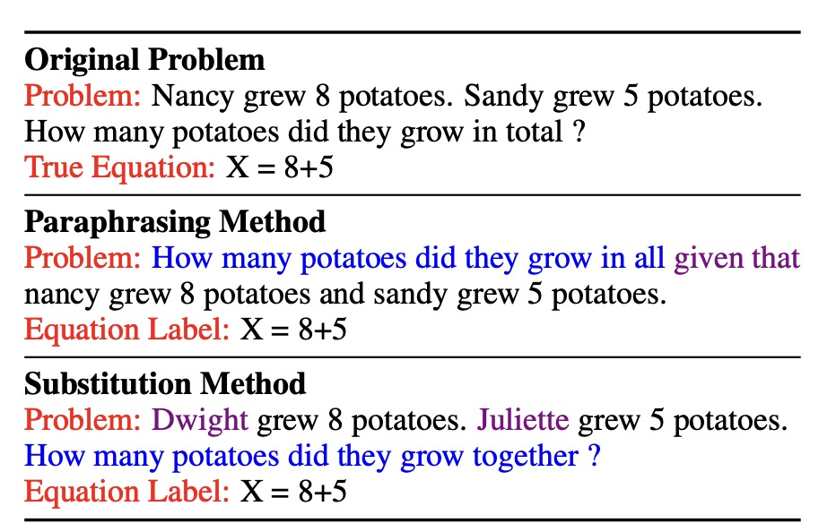
· The high-quality math reasoning is scarce and is the key for reasoning task.
· Math reasoning problem data is hard to annotate by humans.
Synthetic Data
💡But Synthesizing math reasoning problems which are rich in logic is difficult !
(Vivek et.al, NAACL 2022)
Notes:
The data challenge is:

Slide 12
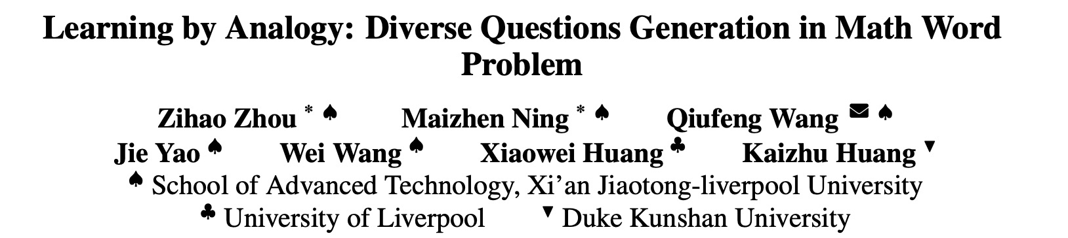
(ACL 2023 Findings)

Slide 13
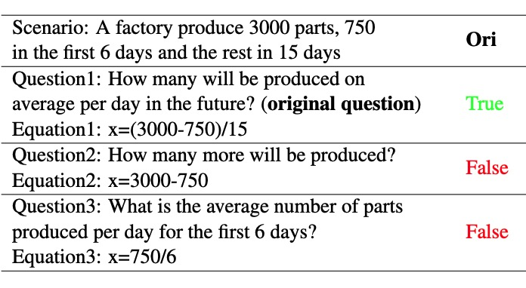
MWP solvers are trained simply based
on single question with each problem.
Similar data in training set
Unseen data in training set

Slide 14
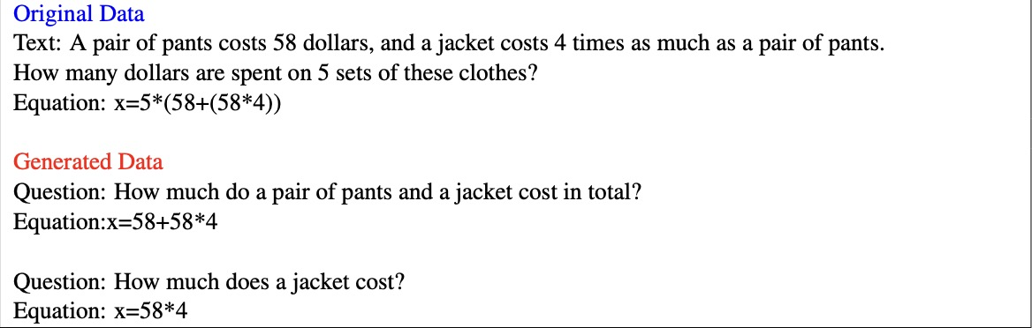
We aim to generate diverse questions with the same scenario to understand the problem:

Slide 15
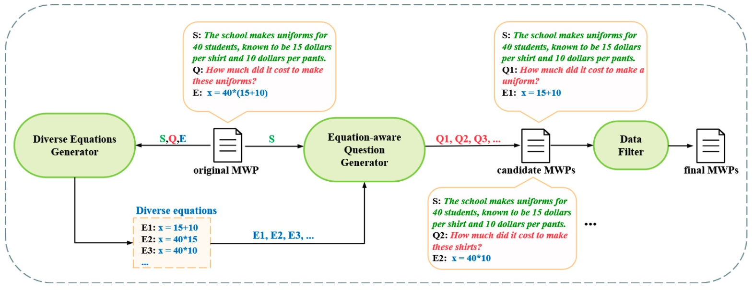
Step 1: Generate the Answer
Step 3: Data Quality
Step 2: Back Translation

Slide 16

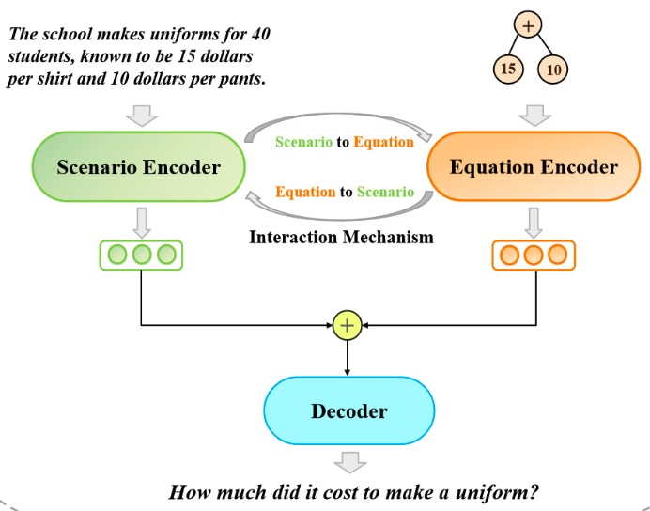
Equation Generator
Question Generator
Diverse equations can lead to diverse questions.
Problem:
The school makes uniforms for 40 students, known to be 15 dollars per shirt and 10 dollars per pants. How much did it cost to make these uniforms?
Equation:
40*(15+10)
· Sub-equation based: 15 + 10
· Unit Based:
Combine Numbers in MWP with operators( + - * / )
— same unit(+, -, /): 15 + 10 , 15 - 10 , 15 / 10
— different units(*): 40 * 15 , 40 * 10
Data Filter
Sample
k
Generated
Question
Pass if Answer
= Predictions
Expert Model

Slide 17
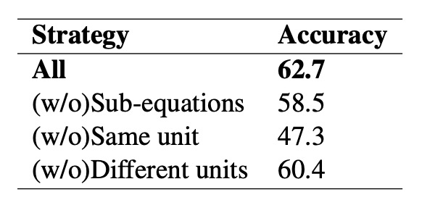
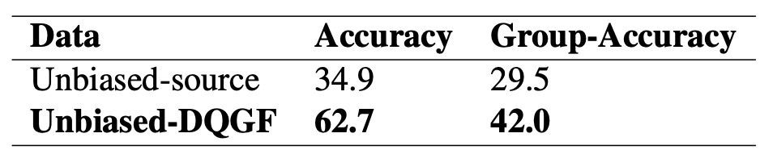
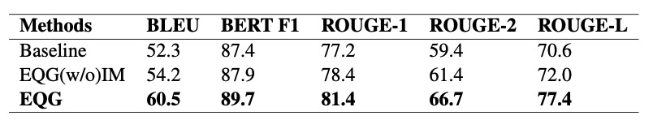
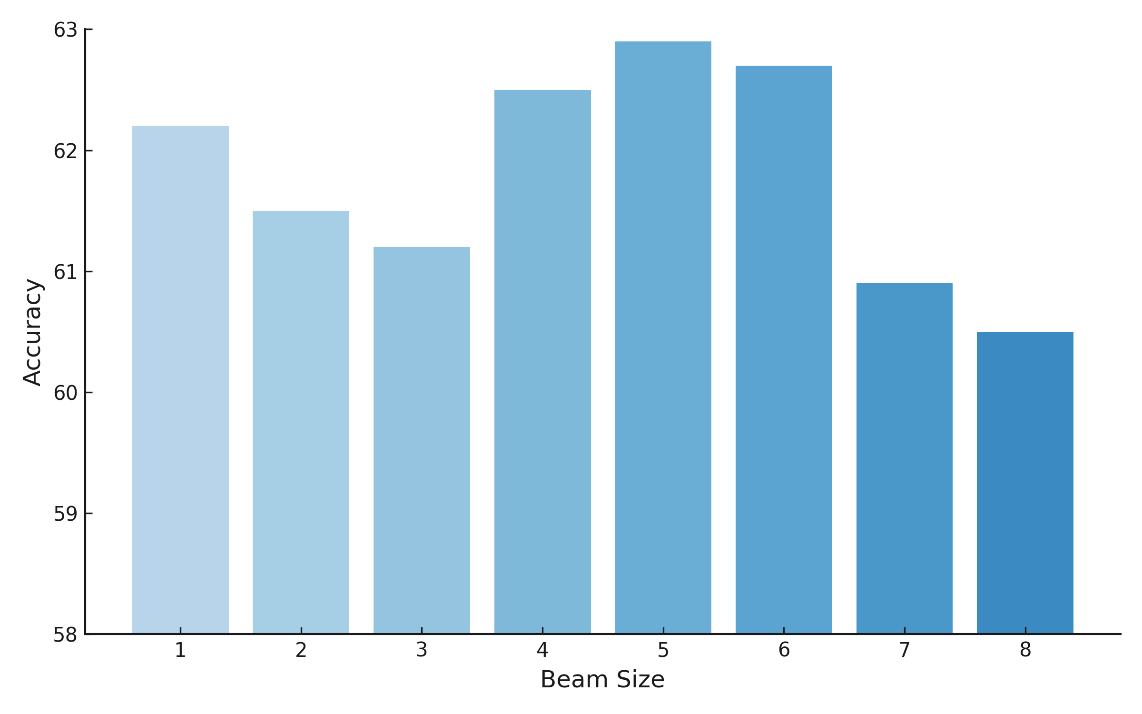
· Overall Performance:
27.8% increase in diverse questions evaluation.
· Diverse Equations Generator:
Diversity is important for data.
· Equation-aware Question Generator
· Data Filter:
Tradeoff between quality and quantity.
Notes:
Result:…

Slide 18
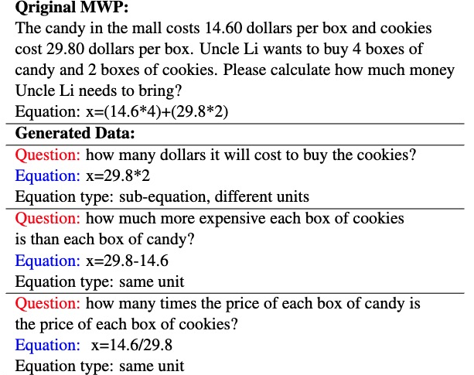
New Dataset: DiverseMath23k
We apply our trained framework on Math23k to create a diverse Chinese MWP dataset (called DiverseMath23K) with diverse questions, which contains 38,320, 1,255, 1,728 MWPs for training, validation, and testing respectively.

Slide 19
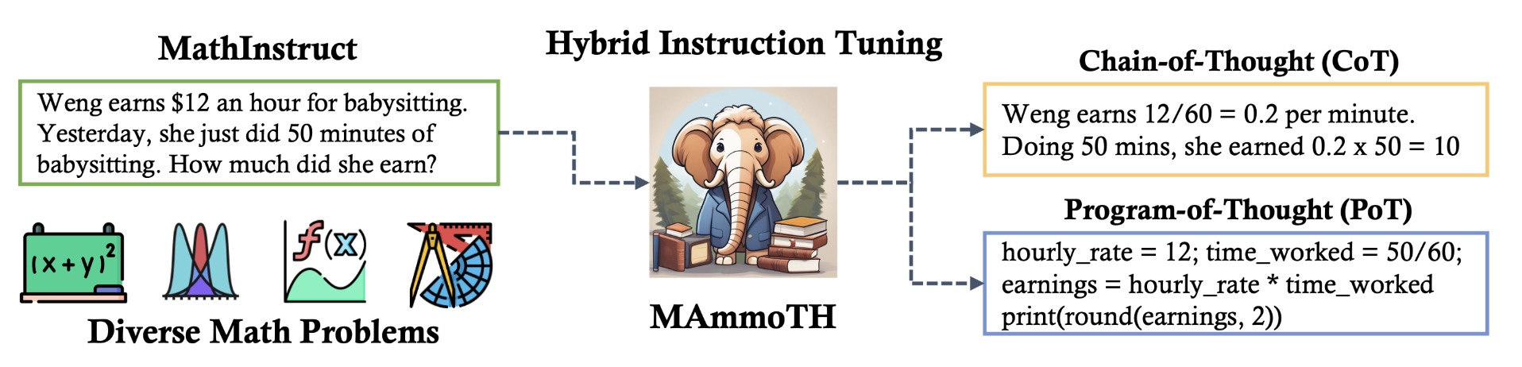
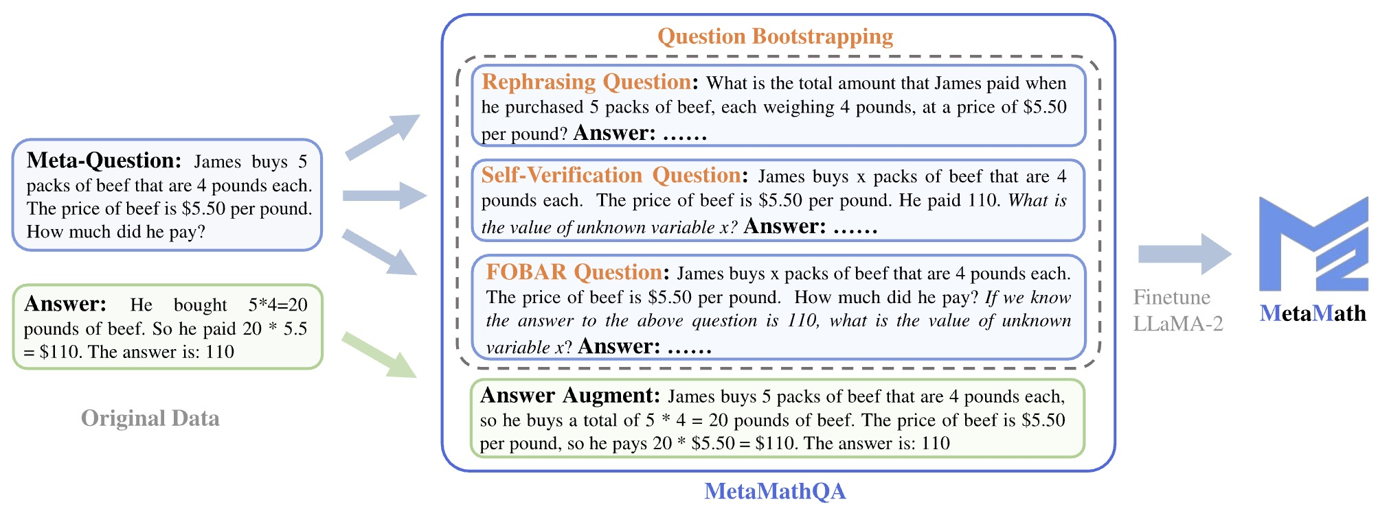
In the era of LLMs
· Synthetic data become more and more important (not only in math reasoning).
(Yue et.al, ICLR 2024)
(Yu et.al, ICLR 2024)
· Synthetic data framework is easier to design due to the flexibility of LLMs.

Slide 20
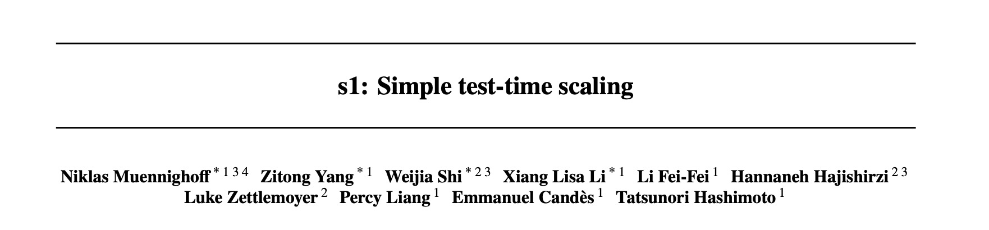
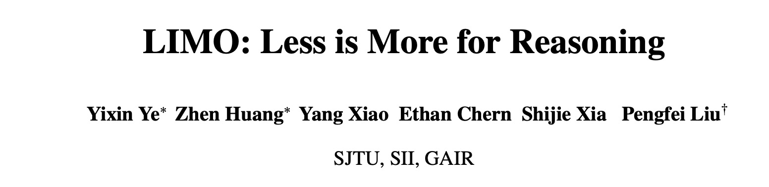
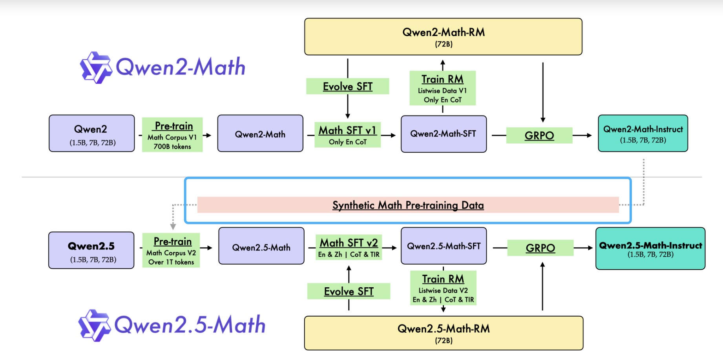
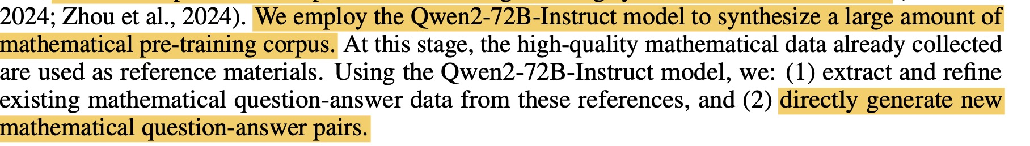
In the era of LLMs (about Less is More)
SFT on Qwen model with 1k data can get good performance:
Actually, the Qwen base models have been pretrained on huge number of synthetic math QA pairs:

Slide 21
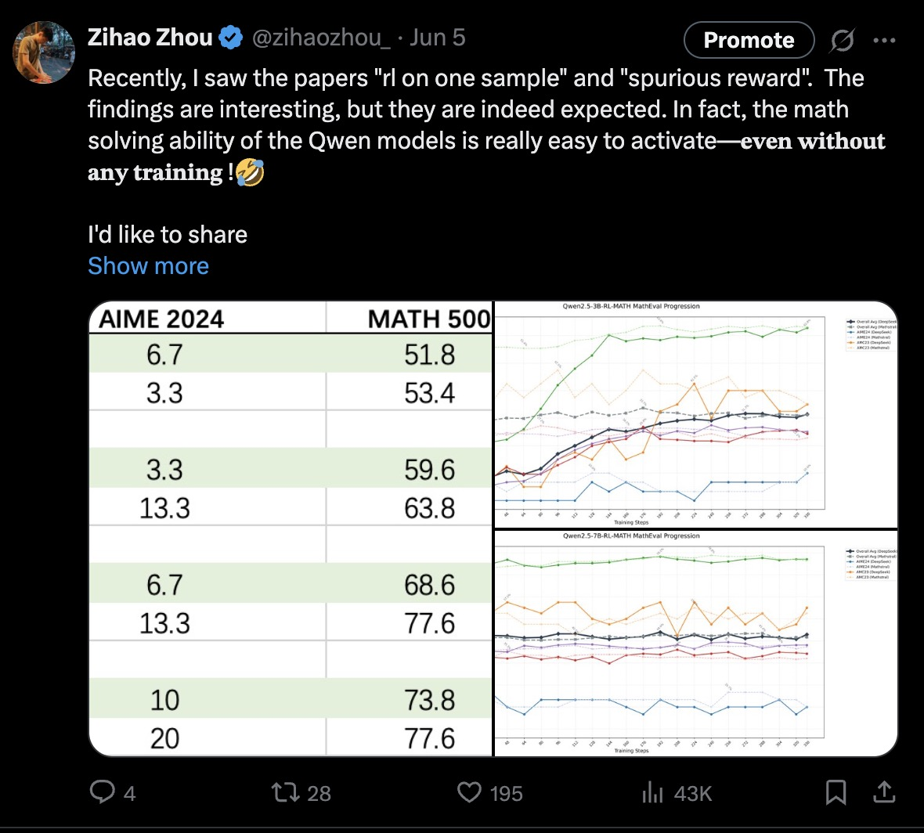
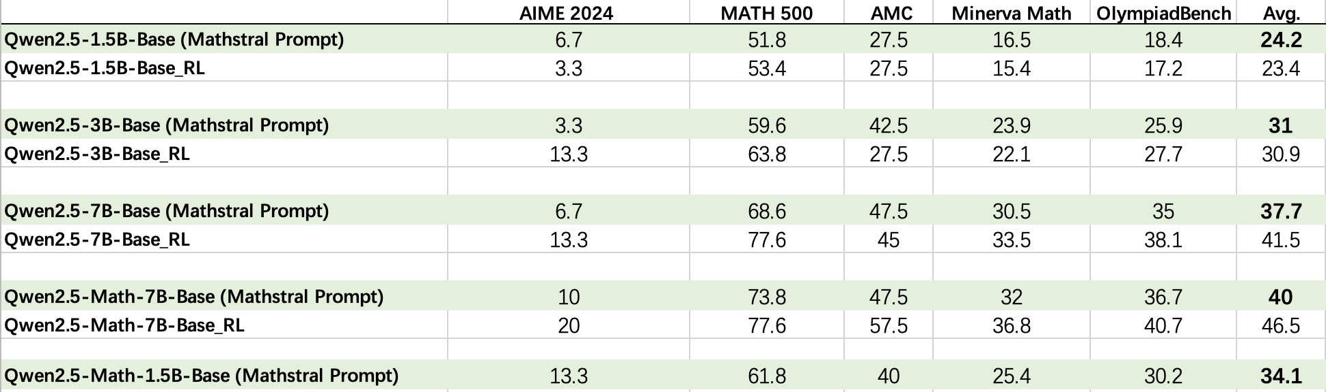
In the era of LLMs (about Less is More)
The math solving ability of the Qwen models is really easy to activate—𝐞𝐯𝐞𝐧 𝐰𝐢𝐭𝐡𝐨𝐮𝐭 𝐚𝐧𝐲 𝐭𝐫𝐚𝐢𝐧𝐢𝐧𝐠.

Slide 22
Talk Overview
· Part 1: Boosting Mathematical Reasoning with Synthetic Data
· Part 2: Evaluating Mathematical Reasoning of Large Language Models
· Part 3: Advancing Math Reasoning with Environment Learning

Slide 23
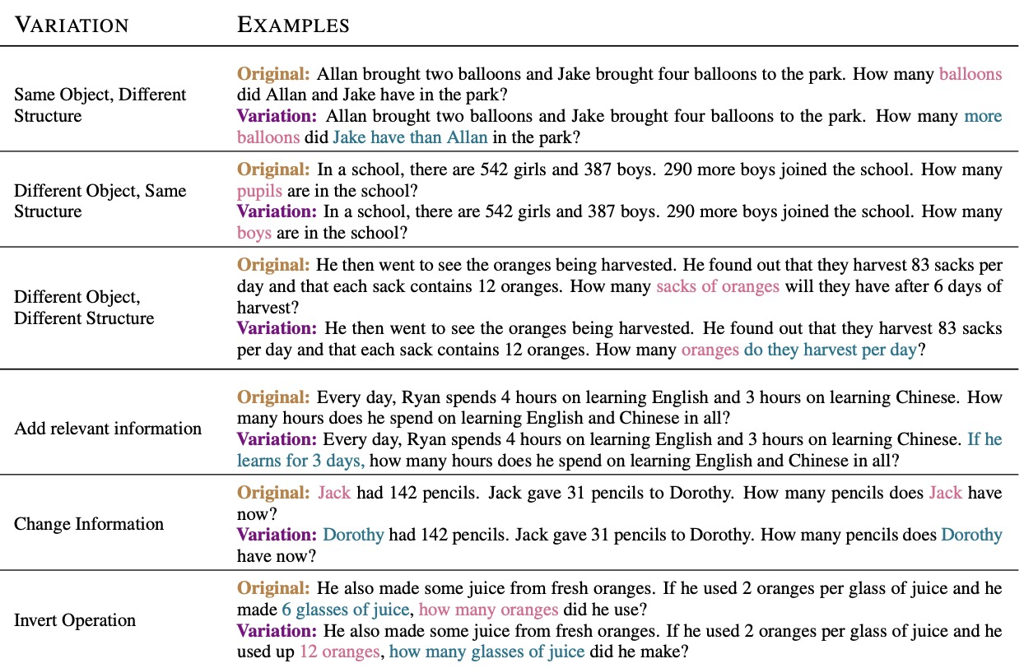
In 2023, ChatGPT is coming, it can achieve good performance on simple math QA.
Is the math reasoning ability of LLMs robust? (Reasoning/Memorization)
ChatGPT achieves 85.2% accuracy on rule-based disturbance like SVAMP (Patel et al. 2021).

Slide 24
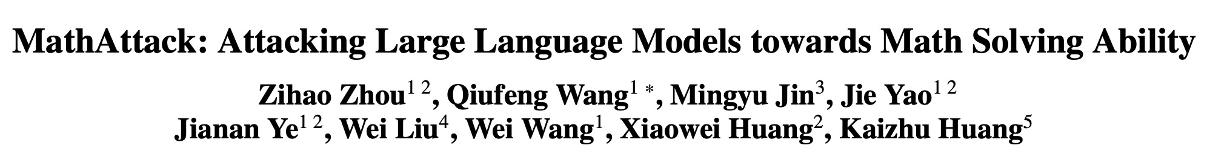
(AAAI 2024)

Slide 25
Text Attack: Iteratively attacking LLMs until predicting wrongly.
💡Attacking math problem solver is different from attacking other NLP tasks where mathematical logic cannot be changed, hence we cannot directly apply current adversarial attacking methods.
Attack other tasks:
F(X) = Y, F(X’) != Y
X’ final = argmax Sim(X,X’), s.t. F(X) != F (X’)
X : Original Input
Y: Ground Truth
X’: Adversarial Example
F(X) = Y, F(X’) != Y
MathAttack:
F(X) = Y, F(X’) != Y,
X’final = argmax Sim(X, X’), s.t. F(X) != F (X’), Logic(X) = Logic(X’)

Slide 26
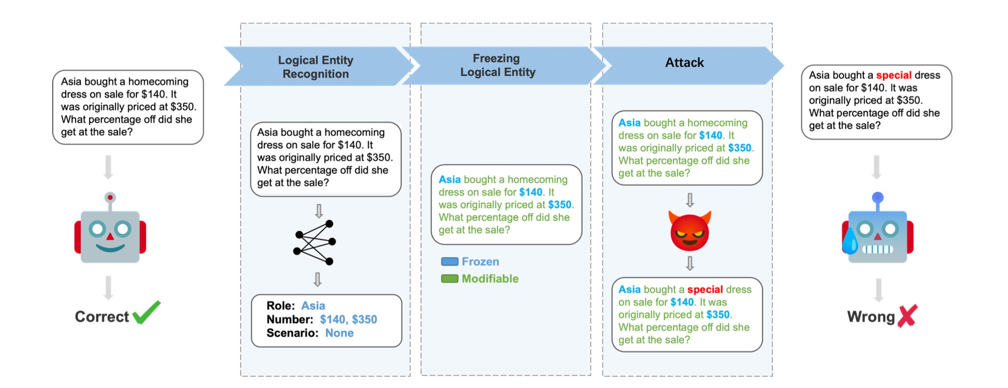

Slide 27
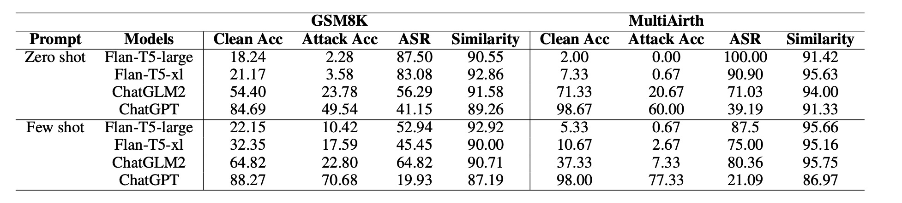
· MathAttack can effectively attack the math solving ability of large language models.
· Employing few-shot could enhance more robust, leading to a lower ASR.

Slide 28
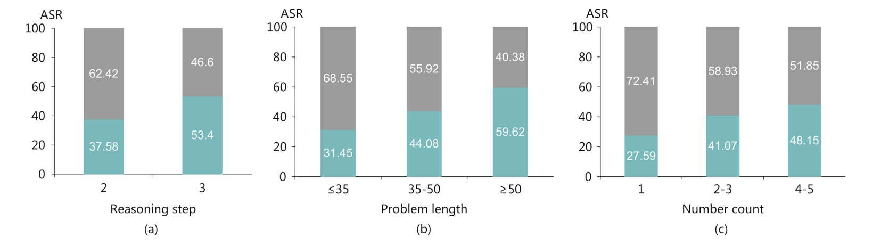
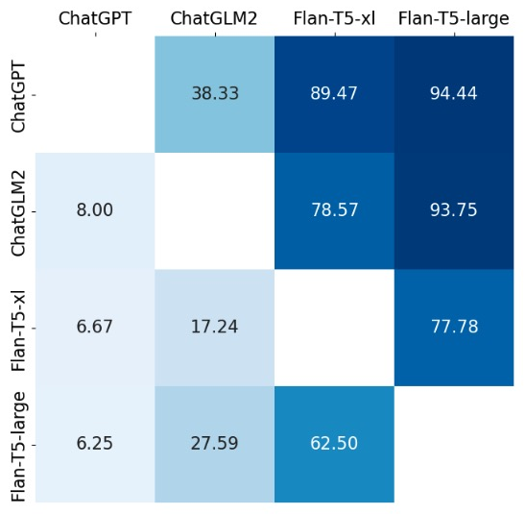
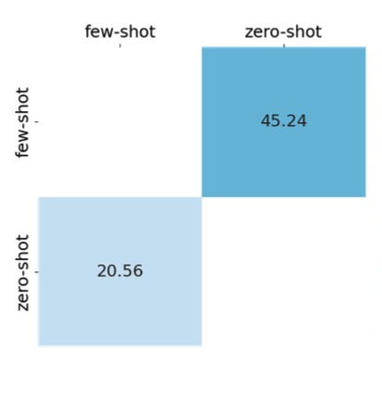
· In difficult problems, LLMs solve them more depend on memorizing.
· Transferability between
models and prompts.

Slide 29
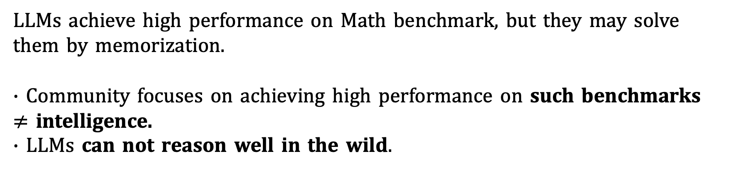
After MathAttack…
LLMs achieve high performance on Math benchmark, but they may solve them by memorization.
· Community focuses on achieving high performance on such benchmarks $≠$ intelligence.
· LLMs can not reason well in the wild.

Slide 30
What we want?
A benchmark paradigm can evaluate the genuine math reasoning ability in the real world.
Further, the shortcomings of models could be identified . 🔍

Slide 31
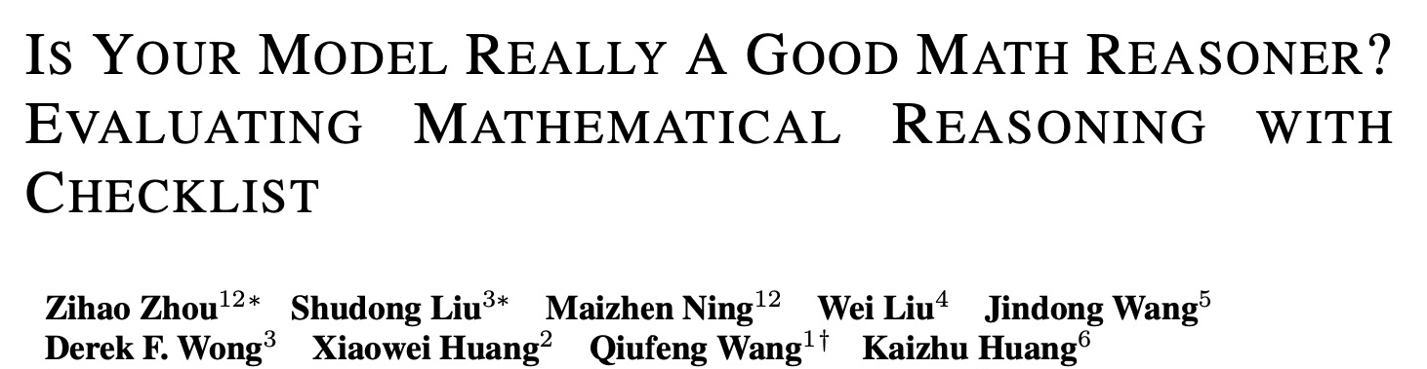
(ICLR 2025)

Slide 32
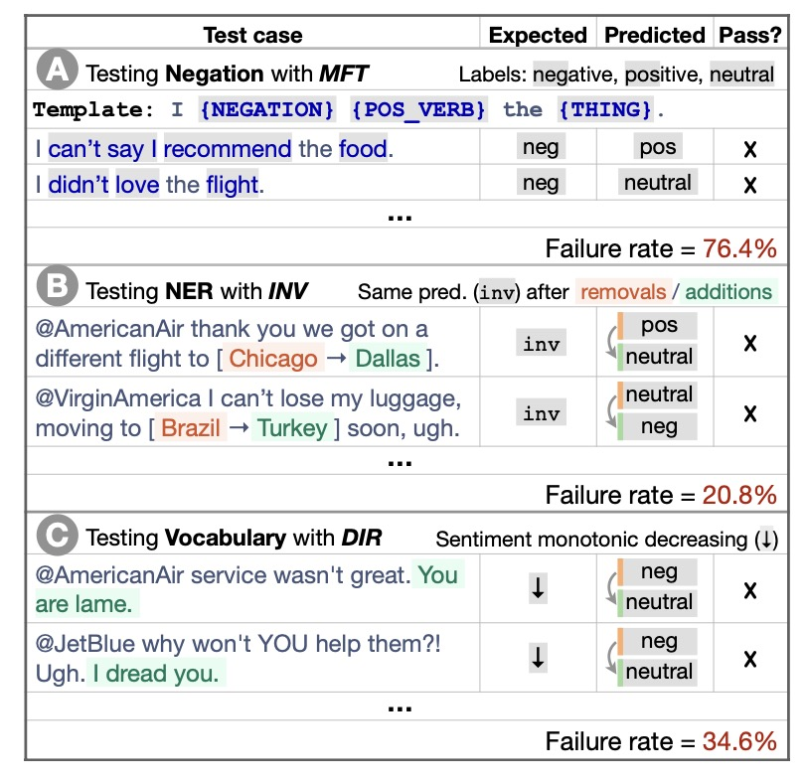
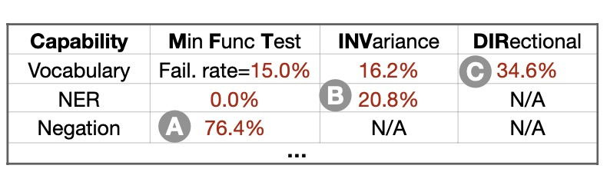
MathCheck
· If a model really understands a problem, it should robustly work across various tasks about this problem.
· NLP Checklist (Ribeiro et al, ACL 2020)

Slide 33



Original Data
A robe takes 2 bolts of blue fiber and half that much white fiber. How many bolts in total does it take?
Task Generalization
"answer": 3.0
Reasoning
Robustness
MathCheck

Slide 34
Reasoning Robustness
Problem Understanding:
Transforming the original problem into a new one that uses different wording or different sentence structures. It pays more attention to semantic robustness.
A robe takes 2 bolts of blue fiber and half that much white fiber. How many bolts in total does it take?
To make a robe, you need 2 bolts of blue fiber and half as many bolts of white fiber compared to blue. What is the total number of bolts required for the robe?
"answer": 3.0
"answer": 3.0
MathAttack

Slide 35
Reasoning Robustness
Irrelevant Disturbance:
Inserting irrelevant conditions that are related to the topic of the original question, but have no impact on the final answer.
A tailor is crafting a luxurious robe. The design requires 2 bolts of blue fiber and half that amount of white fiber. To add grandeur, the tailor also considered using 3 bolts of golden thread from the sun's rays, but eventually decided it would be too gaudy for the ceremony. How many bolts in total are needed for the robe, disregarding the golden thread?
A robe takes 2 bolts of blue fiber and half that much white fiber. How many bolts in total does it take?
"answer": 3.0
"answer": 3.0

Slide 36
Reasoning Robustness
Scenario Understanding:
When models comprehend the scenario of a math problem and its underlying logic, they should be able to solve other questions within that scenario.
A robe takes 2 bolts of blue fiber and half that much white fiber. How many bolts in total does it take?
A robe takes x bolts of blue fiber and half that much white fiber. It takes 3 bolts in total. What is the value of unknown variable x?
"answer": 3.0
"answer": 2.0
DiverseMWP

Slide 37
Task Generalization
Answerable Judging:
Given a math problem, models need to determine whether the problem provides sufficient information to answer the question.
A robe takes 2 bolts of blue fiber and half that much white fiber. How many bolts in total does it take?
A robe takes bolts of blue fiber and half that much white fiber. How many bolts in total does it take?
"answer": Unanswerable
"answer": 3.0

Slide 38
Task Generalization
Outcome Judging:
Given a math problem and one of its solutions, let the model determine whether the final answer of the given solution is correct.
A robe takes 2 bolts of blue fiber and half that much white fiber. How many bolts in total does it take?
A robe takes 2 bolts of blue fiber ... How many bolts in total does it take?
“solution”: Step 1: 2 bolts of blue fiber...The answer is 4 bolts in total.
"answer": Incorrect
"answer": 3.0

Slide 39
Task Generalization
Process Judging:
Given a math problem along with its wrong solution, the model is required to identify the step where the errors begin.
A robe takes 2 bolts of blue fiber ... How many bolts in total does it take?
A robe takes 2 bolts of blue fiber and half that much white fiber. How many bolts in total does it take?
"solution": Step 1: Identify the amount ... Step 3: Multiply the bolts of blue and white fiber together to find the total number of bolts. The answer is 2 bolts.
"answer": Step 3
"answer": 3.0

Slide 40
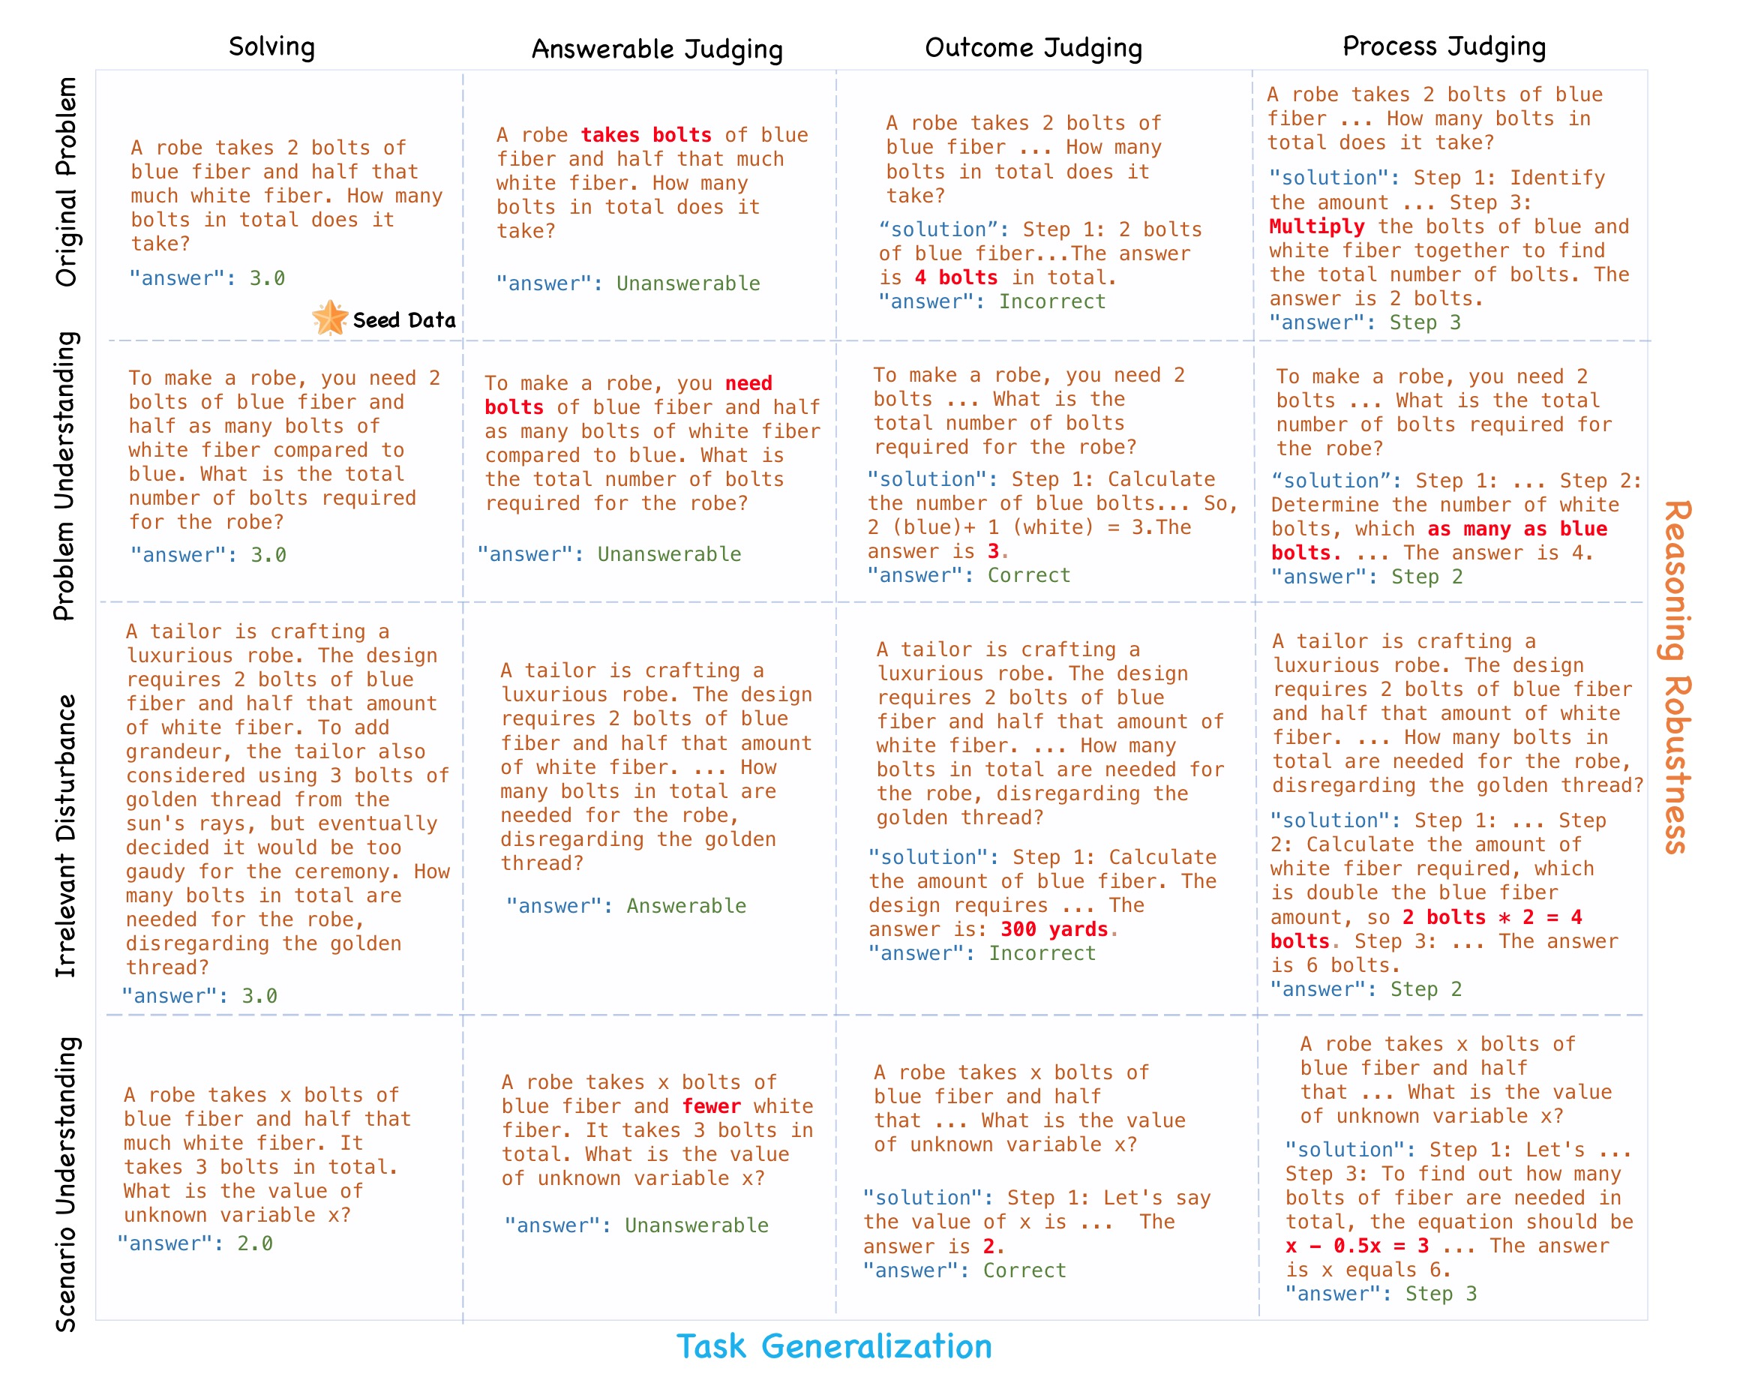
MathCheck

Slide 41
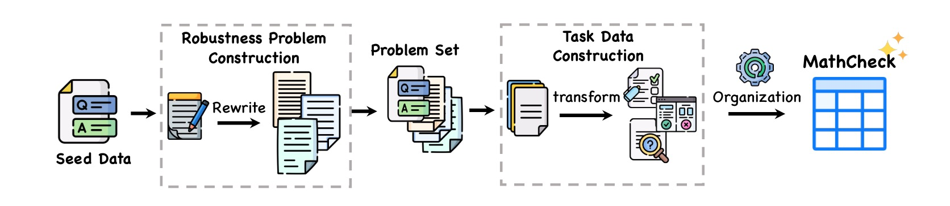
Data Construction
The emergence of large language modes makes data generation flexible and high quality. Therefore we apply (M)LLMs as engines to generate our data.

Slide 42
· Comprehensively evaluate the mathematical reasoning ability.
· Easy to identify shortcomings of models by reasoning behavior testing.
· Existing math datasets can be easily transformed into MathCheck paradigm to become a better assessment of math ability.
· MathCheck provide a framework, which users can add other robustness variant or task.
· Dynamic evaluation method.

Slide 43
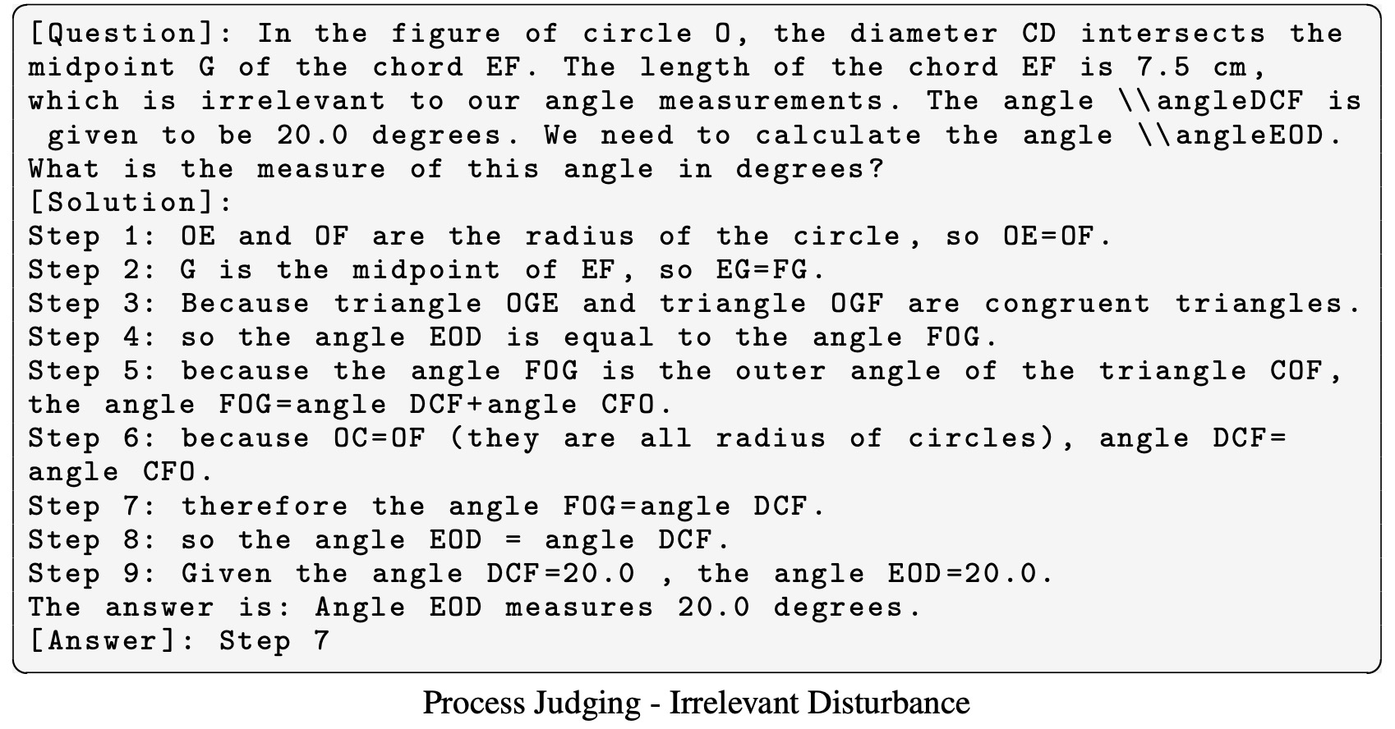
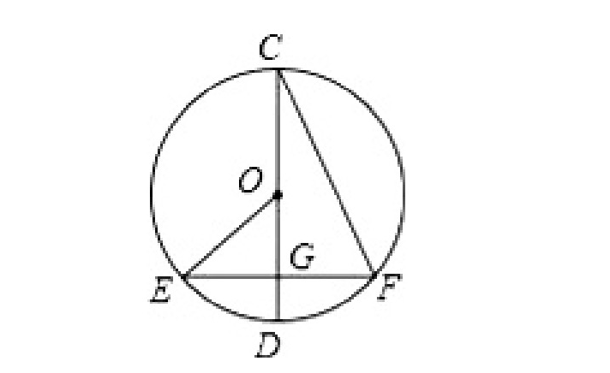
MathCheck-GSM
We choose GSM8k as the seed benchmark, which is the most widely used for evaluating mathematical textual reasoning capability. Subsequently, we generated 129 MathCheck style groups, totaling 3,096 high-quality data.
MathCheck-GEO
A dataset for Geometry problems, which is the representative task for evaluating multi-modal reasoning capability. Subsequently, we generated 60 MATHCHECK style groups, totaling 1,440 high-quality data.
💡All datasets were subjected to meticulous manual validation for reliability

Slide 44
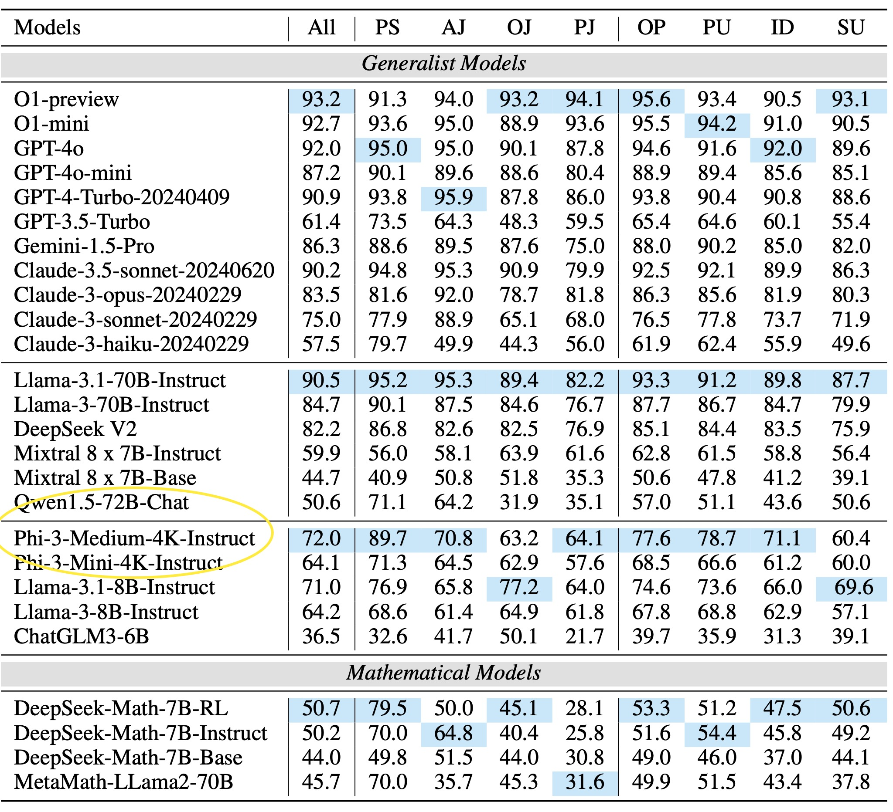
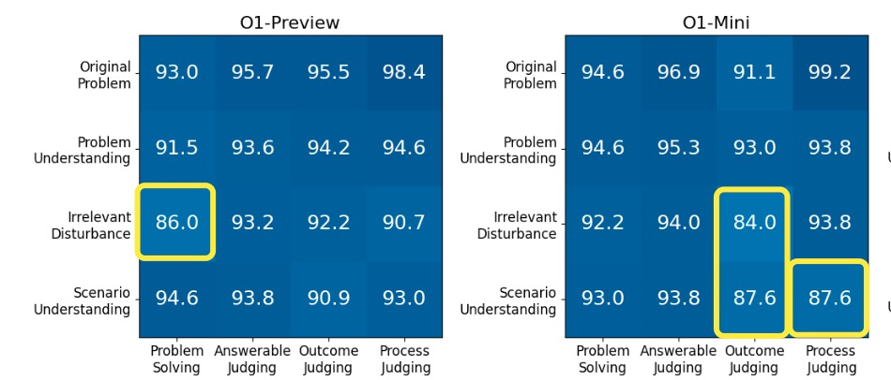
· Frontier LLMs like O1 continue to achieve superior performance in our MathCheck, but many other model families exhibit a significant decline.
· Some generalist models exhibit reasoning inconsistency
· Math-customized models underperforms in tasks other than problem solving.
Notes:
· 123

Slide 45
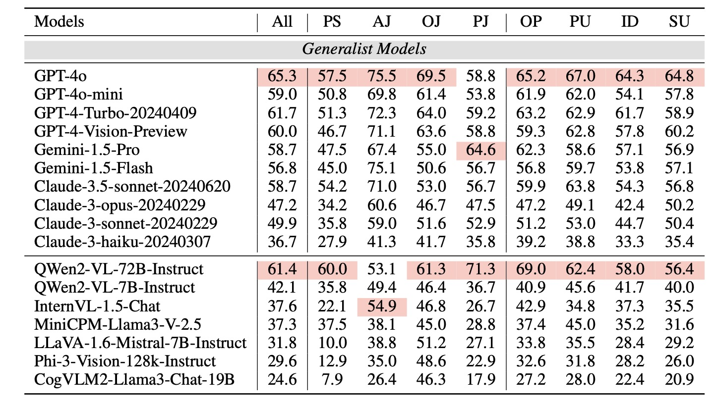
Results
· GPT-4o achieves a top score of 65.3. Claude-3-sonnet is slightly superior in visual contexts compared to Claude-3-opus.
· Open-source MLLMs still have significant room for improvement, meriting further exploration by the research community. Qwen2-VL-70B attaining 60.4 over the GPT-4-Vision-Preview.

Slide 46
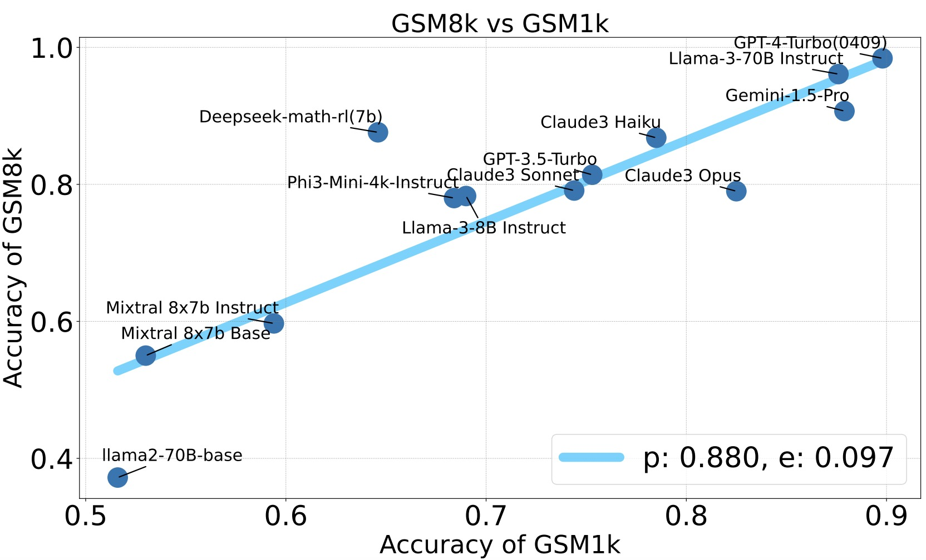
MathCheck is closer to Intelligence
Private data: GSM1k (Zhang et al, ICLR 2025)

Slide 47
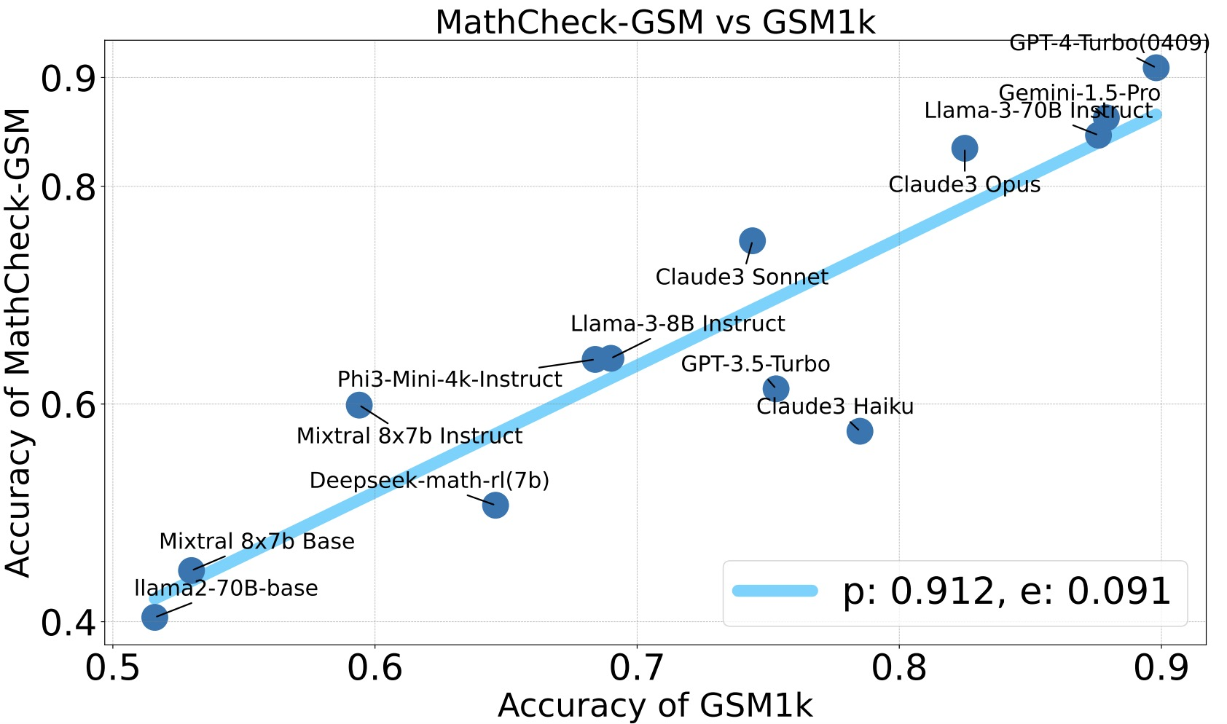
MathCheck is closer to Intelligence
Private data: GSM1k (Zhang et al, ICLR 2025)
It shows that MathCheck has a higher correlation coefficient with GSM1k, mitigating bias evaluation caused by overfitting and data contamination.

Slide 48
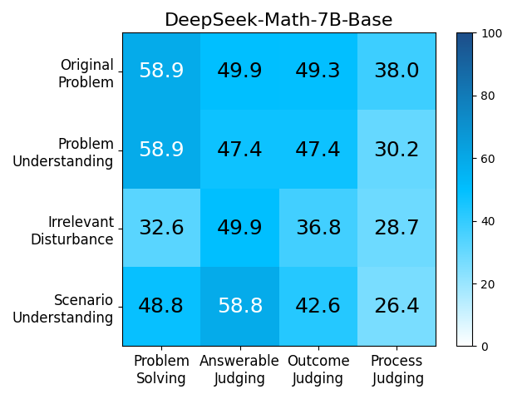
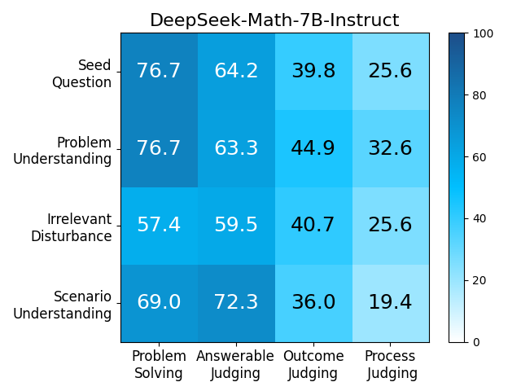
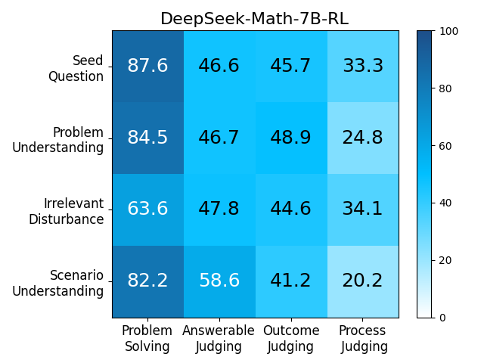



Behavior of Math Models
It implies that training solely on massive solving data is not the right direction to improve mathematical reasoning ability

Slide 49




Reasoning Consistency
These inconsistency behaviors of generalist models are highly similar to mathematical models, revealing that they may conduct excessive decoration on original benchmarks.

Slide 50

Other Reasoning Task — Date Understanding

Slide 51

Other Reasoning Task — Code Generation

Slide 52
· Promoting research on the reasoning benchmark paradigm (e.g. MathCheck) rather than just solving on single problem.
· The training method/data lead to better reasoning consistency.
· MathCheck design can be adapted to other reasoning tasks (e.g. Code Generation) to help better assess their reasoning ability.

Slide 53
Talk Overview
· Part 1: Boosting Mathematical Reasoning with Synthetic Data
· Part 2: Evaluating Mathematical Reasoning of Large Language Models
· Part 3: Advancing Math Reasoning with Environment Learning

Slide 54

· As the base model becomes stronger, rule-base RL (0/1) can achieve remarkable mathematical reasoning ability.
· Learning from environment feedback is important for advancing math reasoning (super-human).
Environment Tuning

Slide 55

(Under Review)

Slide 56


IMO Diagram:

Slide 57

Verifiable:

Slide 58



Future work of GeoSDF:
· Auto-formalization
· Self-play framework
Evaluator
Problem
Generator
Unlabeled Problems
Auto- Formalization
Policy Model
Learning
GeoSDF

Slide 59


If there is no verifiable environment for your task, you can find an indirect verifiable environment and the RL can generalize well.

Slide 60
Policy Model
Direct, Longcot, Agent…
Environment
Learning Algorithm
(Pre)training for a stronger model
Environment Construction

Slide 61
Thank You!!

